Slide 1
B.Sc semester –I
PAPER –CC2 (ECOLOGY)
UNIT -1
Introduction to ecology
By Ms. Mampi Dey
Abhedananda Mahavidyalaya
Sainthia, Birbhum

Slide 2
HISTORY OF ECOLOGY :
The term ecology was coined by German biologist Ernst Hackel combining two greek words , OIKOS means “house” and LOGOS means “to study”.
Ecology is a study of the households of the planet earth. According to Odum it is the structure and function of nature.
LEVEL OF ORGANIZATION : The basic level of ecological organization starts with the individual ( a single plant or insect or bird or human etc.) The next level of organization is the population , collection of individuals of the same species within an area or region.next is community ,made up of different populations of interacting plants, animals and microorganisms within some defined geographical area. The next level is Ecosystem , an ecosystem consists of different communities of organisms associated within a physivcally defined space. Terrestrial ecosystems can be grouped into units of similar nature , termed as biomes or into a geographical unit , termed landscapes.
INDIVIDUAL
POPULATION
COMMUNITY
ECOSYSTEM
BIOMES/ LANDSCAPES.

Slide 3
Based on the level of organization ecology is classified into autoecology and synecology.
AUTOECOLOGY : It is the study of interaction between organisms and their environments at the level of an individual, a population or an entire species.These are the studies for details oftheir geographic distribution, morphology , taxonomic position and life –cycle. E.g- tree in forest.
SYNECOLOGY : It is the study of a biotic community. It is also called community ecology.It deals with the group of organisms.i.e population ecology, community ecology biome ecology or ecosystem ecology . E.g- a forest.
LIMITING FACTOR: Limiting factor is a resource or environmental condition which limits the growth , distribution or abundance of an organism or population within an ecosystem. These can be physical or biological factors.Environmental factor that by its decrease, increase, absence or presence- limits the growth, metabolic processes or distribution of organisms or populations. Density dependent factors are disease ,predation etc. Density independent factors are earthquake , tsunamis , volcanic eruption etc. continue…….

Slide 4
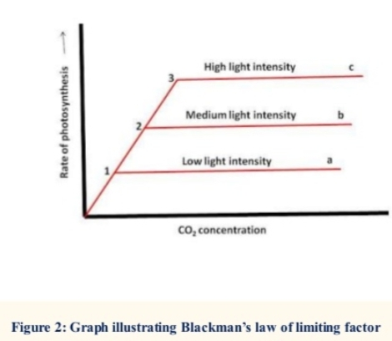
Limiting factors are the factors present in limited supply. Three laws explaining the effect of different factors on organism.
Liebig law of minimum : According to Liebig law of minimum, the distribution of a species will be controlled by that environmental factor for which the organism has the narrowest range of tolerance.
This law was originated after studying and observining the crop and plant growth. The studies reveal that if we increase the supply of nutrient which already present in enough amounts , it does not affect the growth of plants.But when we provide the nutrients which are present in scarcity or in limited supply, growth improvements are detectable. Hence, it is the limiting factor that affects the growth of plants.
2. Blackman’s law of limiting factor : According to this law, a number of factors regulate the biological processes but the factors in different amount affect the process on the whole.
i.e photosynthesis is requires basic components like water, carbondioxide,
Sunlight,chlorophyll,temperature etc present in certain amount, but any of these
Factors is present in scarcity will affect the rate of photosynthesis.

Slide 5
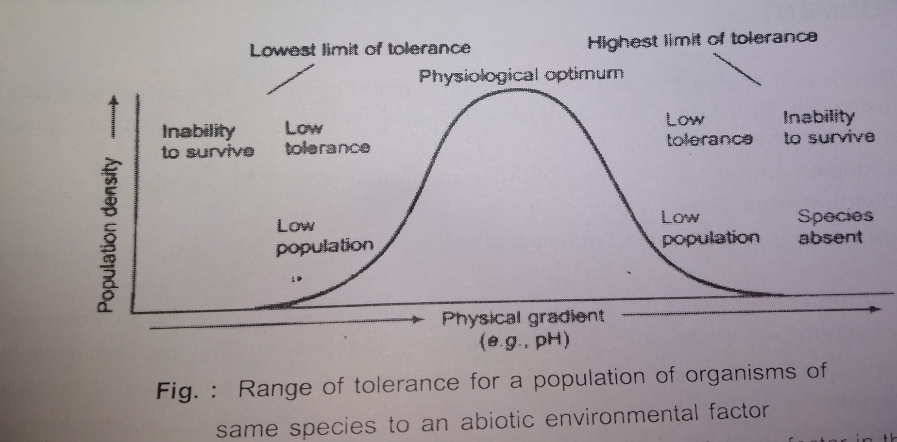
Law of tolerance – Shelford ‘s law : The law of tolerance by shelford’s revealed that the growth and development of organism depends on the maximum and minimum limits of factors involved in the biological process.
A plant or animal may have a wide range of tolerance for one factor in the environment but a relatively narrow range of tolerance for another condition i.e euryhaline and stenohaline.

Slide 6
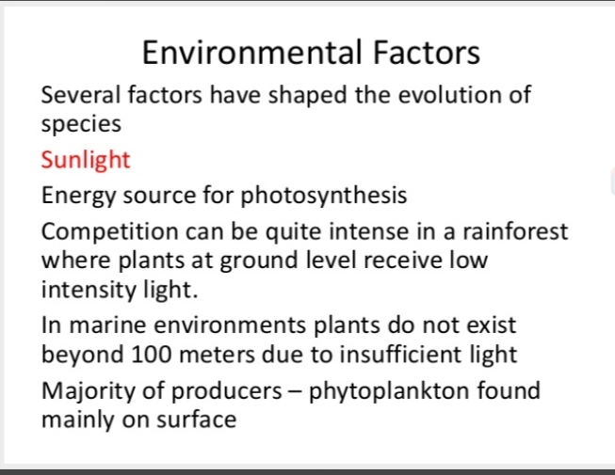
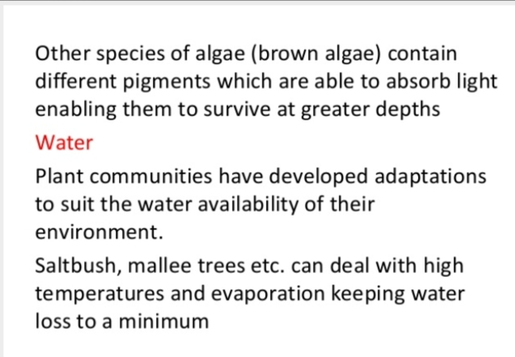
PHYSICAL FACTORS OF ENVIRONMENT : Abiotic or physical factors are grouped into climatic .edaphic and physiographic factors.

Slide 7
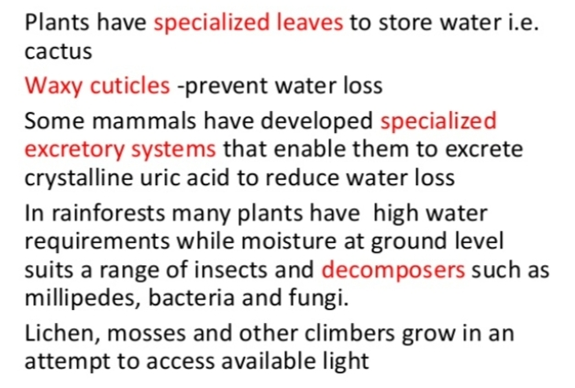
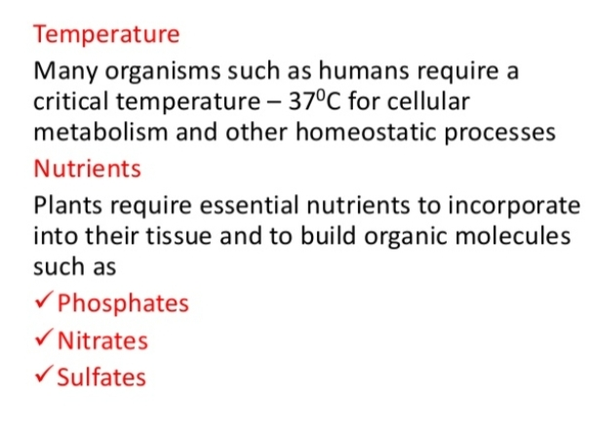
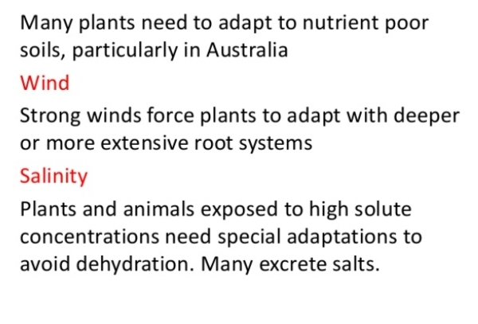

Slide 8
