Slide 1
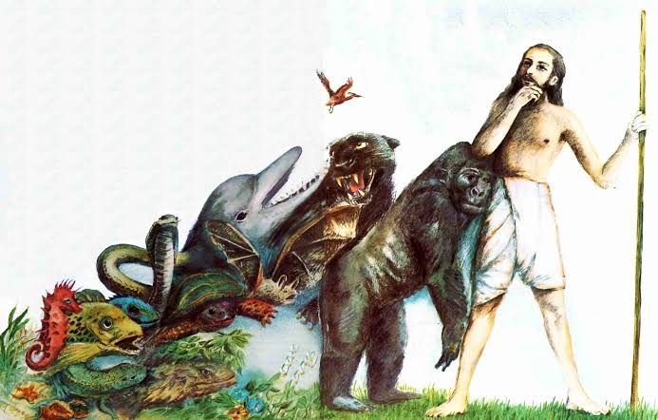
THEORIES OF EVOLUTION
LAMARCKISM AND DARWINISM

Slide 2
LAMARCKISM: inheritance of acquired characters
Lamarckism can be defined as ‘The changes in structure or function of any organ acquired during the life –time of an individual in response to changes in the surrounding environment are inherited by its offsprings and keep on adding up over a period of time’

Slide 3
POSTULATES OF LAMARCKISM
NEW NEEDS : The new need results in the formation of new organ or a part in the body.If the need continues that organ or part also continues to grow.
BY USE AND DISUSE : The new habits involve greater use of certain organs to meet the new need and disuse or lesser use changed condition. E.g- vestigial organs.
INHERITANCE OF ACQUIRED CHARACTERS: The characters acquired by an organism during life time are passed on to the next generation.

Slide 4
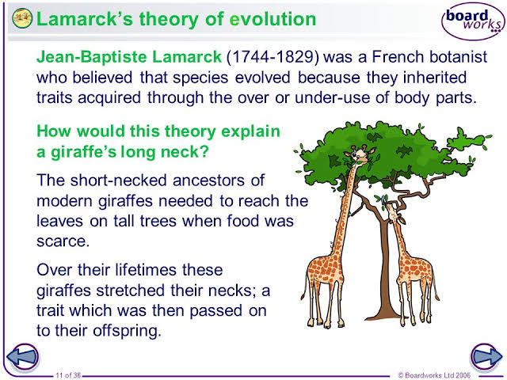
EVIDENCE OF LAMARCKISM :Long neck in Giraffe

Slide 5
Critism of Lamarckism :
Tendency to increase in size
New organs develop when the organisms feel their need.
Reaction to the environment.
Discard of concept inheritance of acquired characters.
Theory of continuity of germplasm.

Slide 6
DARWINISMS : THEORY OF NATURAL SELECTION
(ORIGIN OF SPECIES BY MEANS OF NATURAL SELECTION
PRODIGILITY OF REPRODUCTION.
LIMITATION OF FOOD AND SPACE FOR LIVING.
STRUGGLE FOR EXISTENCE (INTERSPECIFIC AND INTRASPECIFIC).
SURVIVAL OF THE FITTEST.
ORIGIN OF VARIATION.
ORIGIN OF NEW SPECIES.

Slide 7
