Slide 1
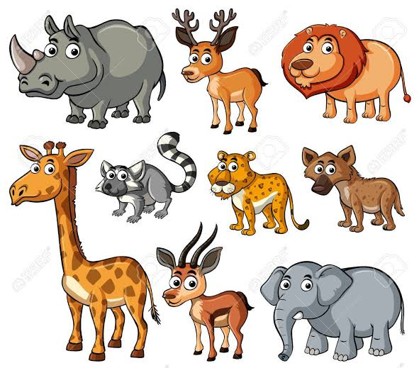
SPECIES CONCEPT
SPECIES AND SPECIATION

Slide 2
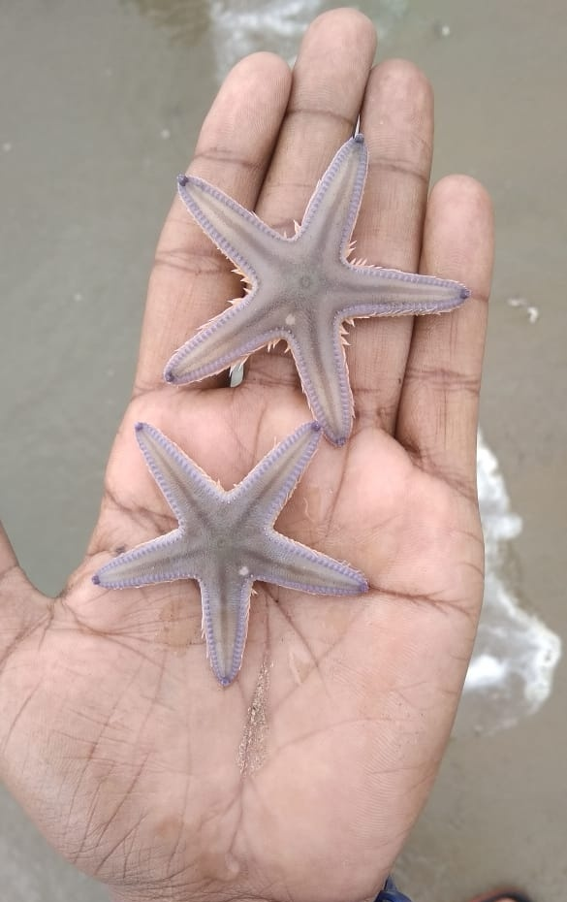
SPECIES:
Species is a group of organism that can interbreed and produce fertile offsprings.

Slide 3
Criteria of species:
Morphological similarities: resemble most of their visible morphological characters.
Ecological basis : that share same ecological niche.
Genetic basis: show close similarity in their genetic karyotype.
Evolutionary aspect: share unique structural and functional characters.
Biolopgical aspect: capable of interbreeding and producing offsprings

Slide 4
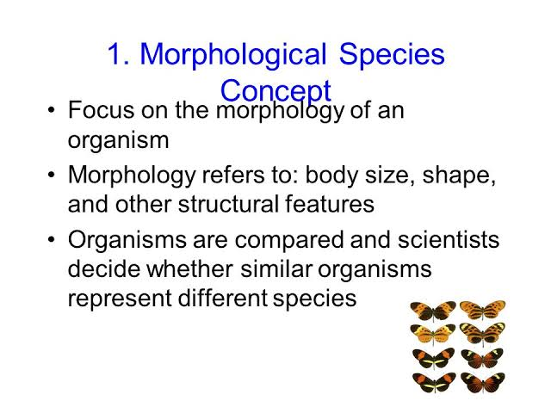

Slide 5
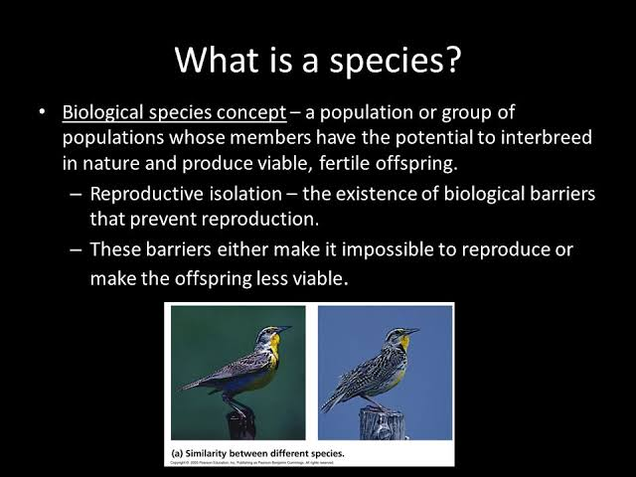

Slide 6
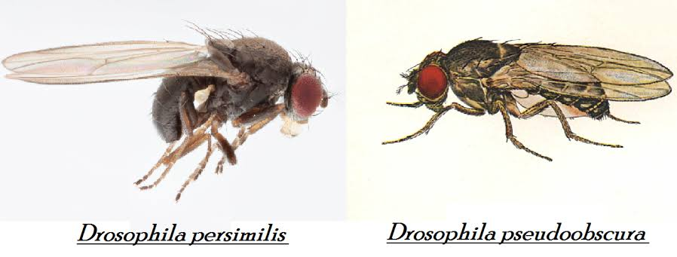
SIBLING SPECIES: Morphologically similar but reproductively isolated from one another.

Slide 7
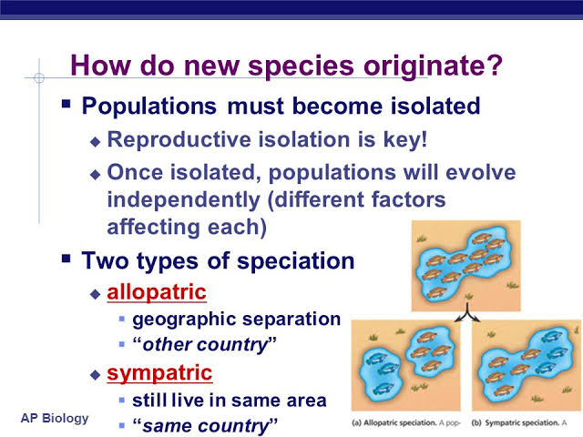
SPECIATION: CREATION OF NEW SPECIES OR ORIGIN OF SPECIES

Slide 8
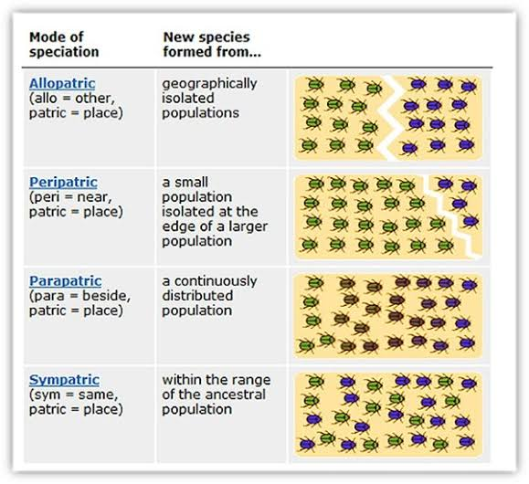
Types of speciation:

