Slide 1
NATURAL SELECTION
INDUSTRIAL MELANISM

Slide 2


Slide 3
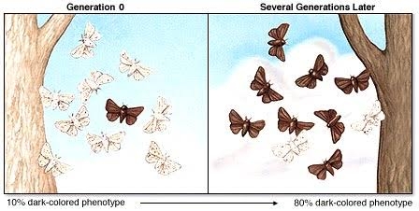

Slide 4
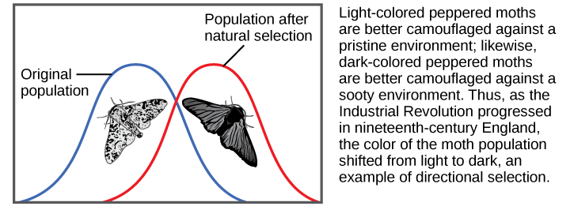

Slide 5
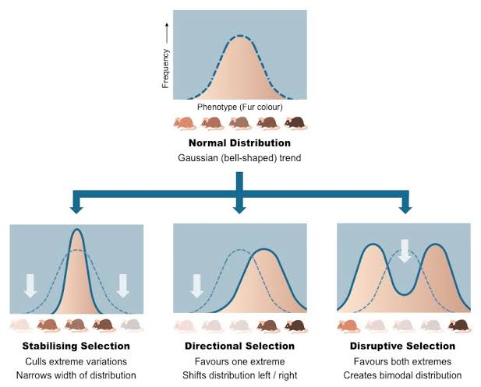
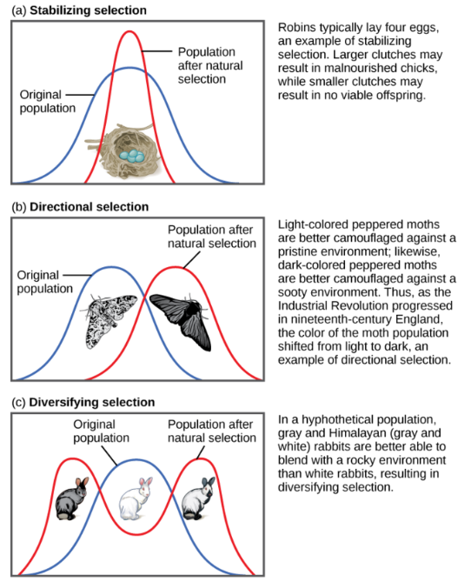
TYPES OF NATURAL SELECTION

Slide 6
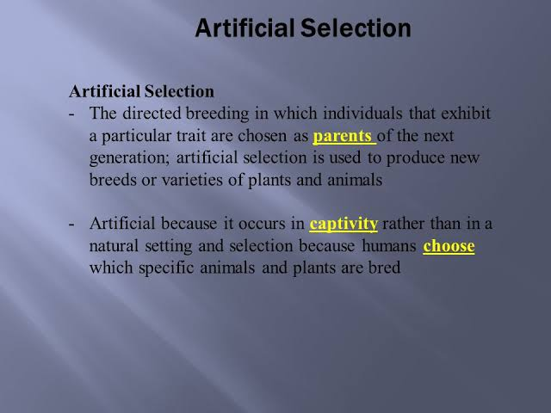

Slide 7
