Slide 1
MENDELIAN EXTENSION
INCOMPLETE DOMINANCE
CO-DOMINANCE
MULTIPLE ALLELES
LETHAL ALLELES
EPISTASIS
POLYGENIC
PLEIOTROPY
SEX INFLUENCE
SEX LIMITED
SEX LINKED.

Slide 2
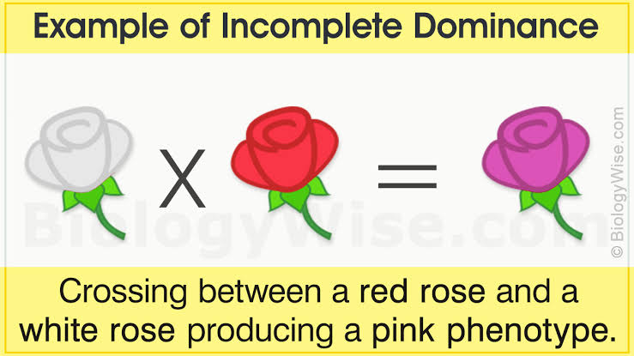
INCOMPLETE DOMINANCE:
The situation in which phenotype of a heterozygote is intermediate between the two homozygotes on some quantitative scale of measurement is called incomplete dominance.

Slide 3
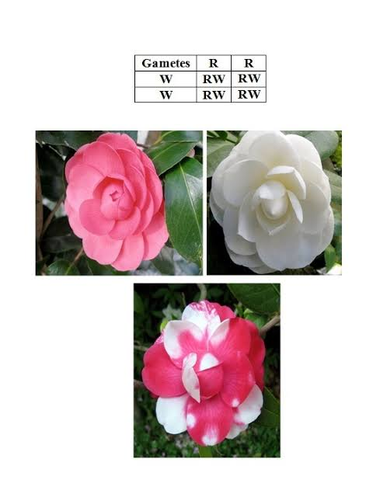
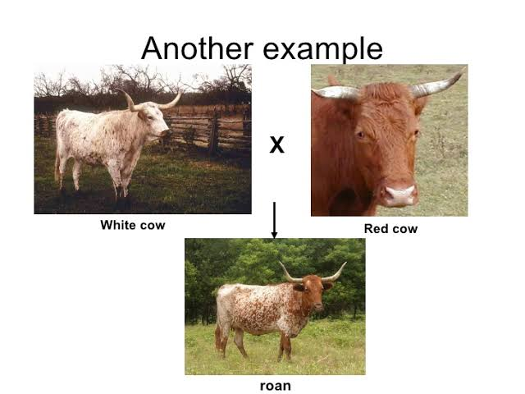
CO-DOMINANCE:
Alleles that lack dominant and recessive relationship and both have capability to express themselves phenotypically in the heterozygous conditions are termed as co-dominance.

Slide 4
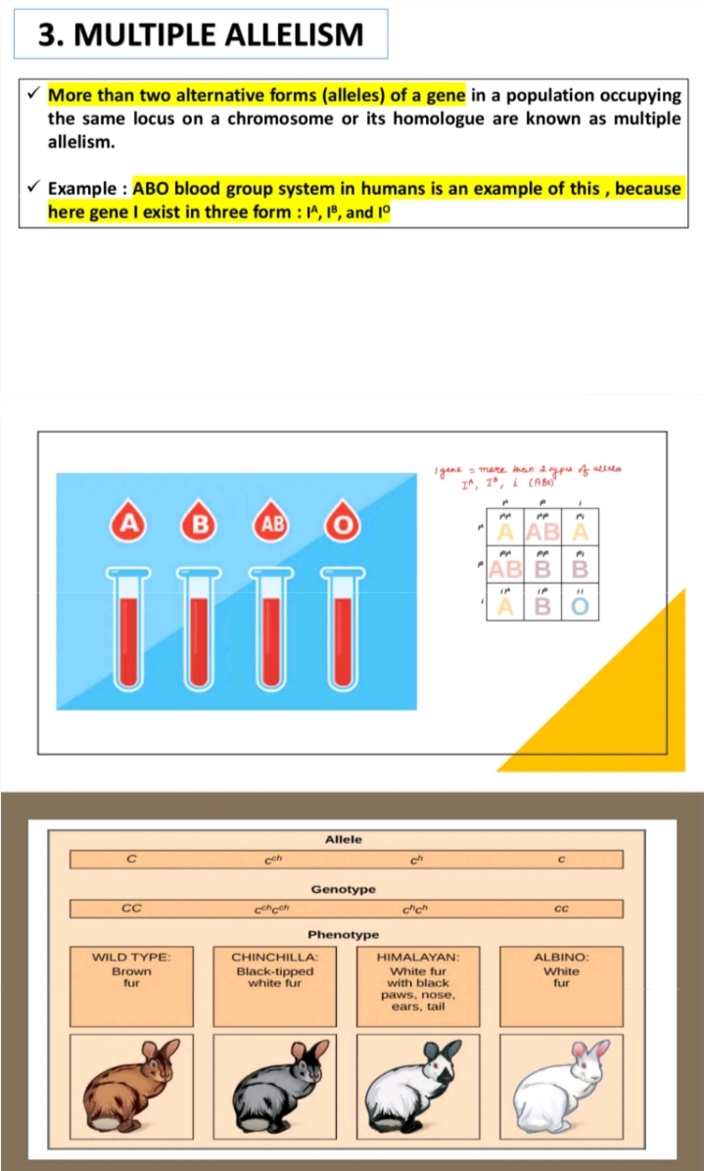

Slide 5
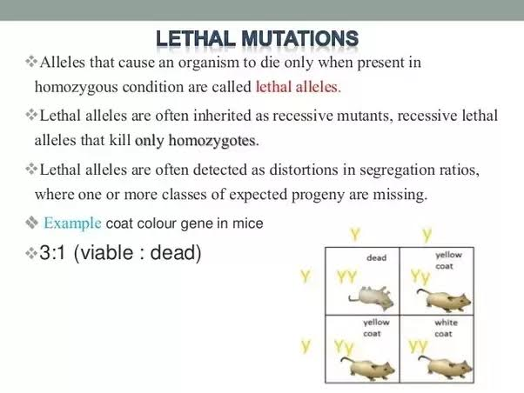

Slide 6
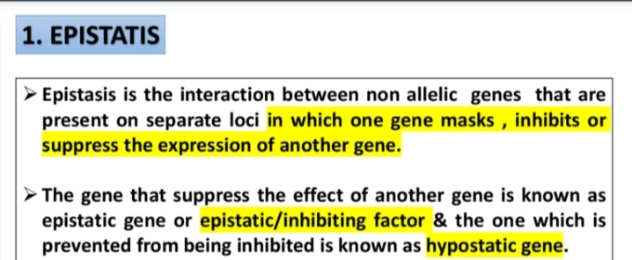
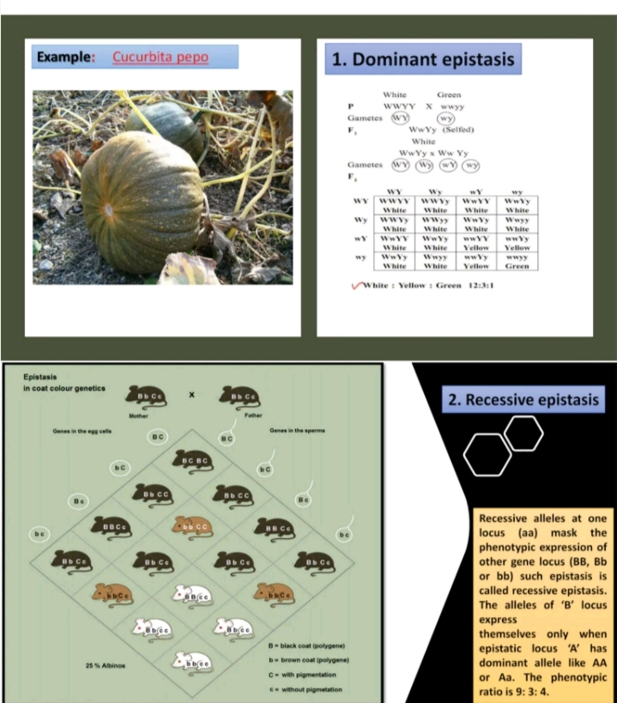

Slide 7
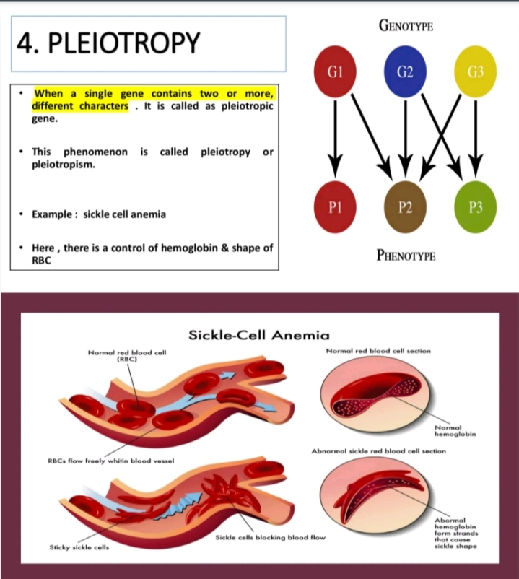

Slide 8
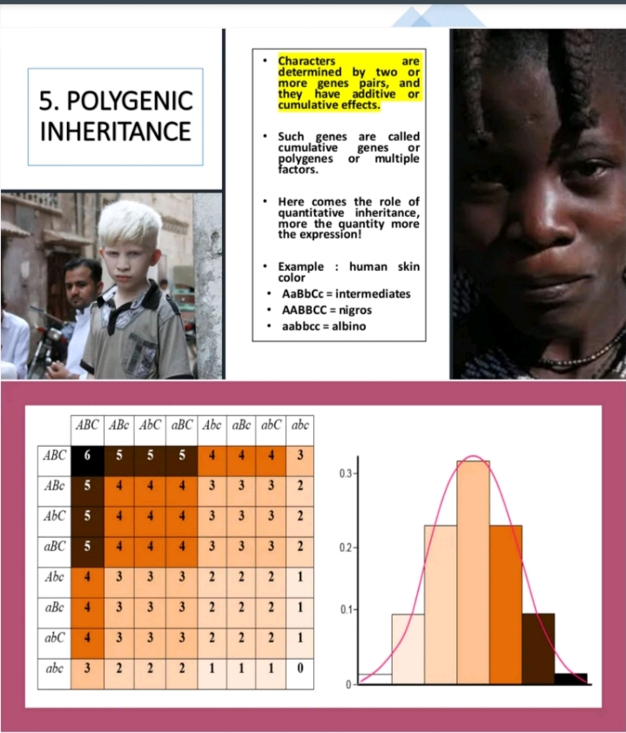

Slide 9
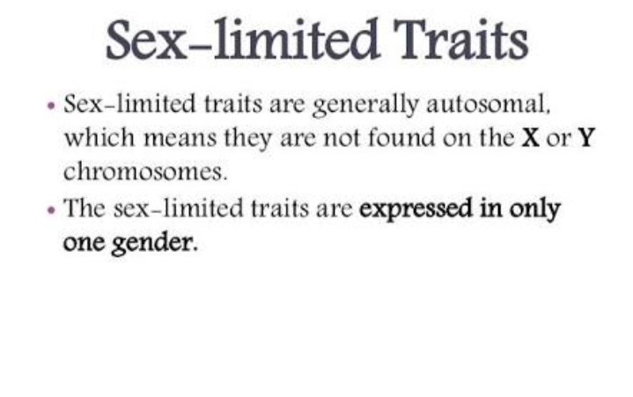
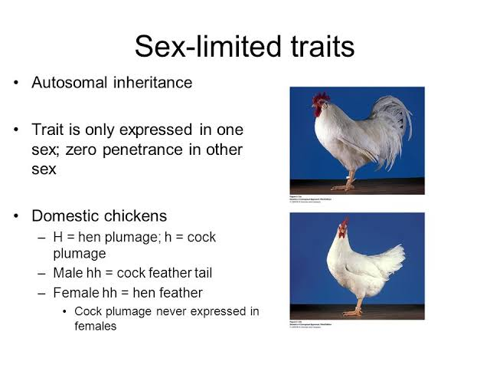

Slide 10
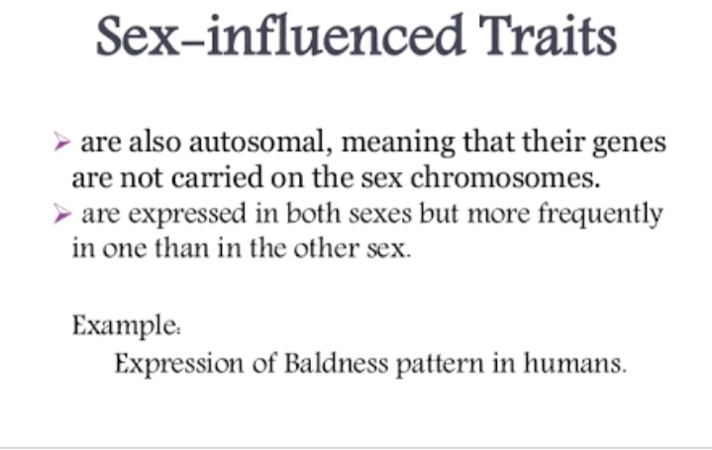
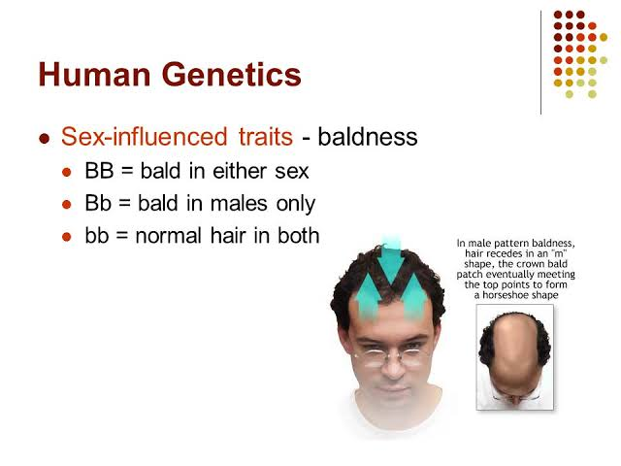
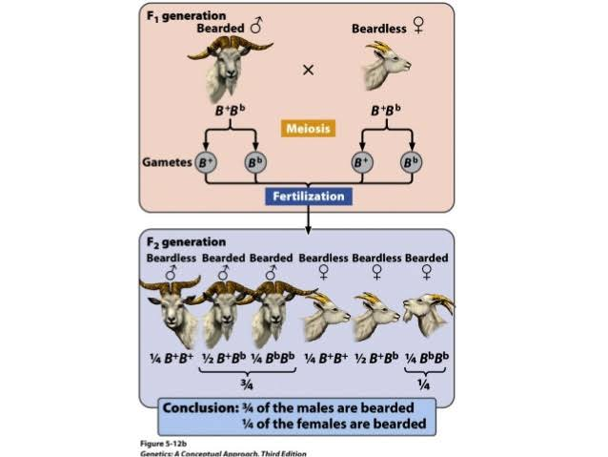

Slide 11
SEX LINKED:
Express either in x chromosome or y chromosome.
X linked trait transmit from male (father)to daughter and y linked from father to son.
E.g: colorblindness, haemophilia y linked:Hairy pinnae.

