Slide 1
B.Sc SEM -3 HONOURS
TOPIC –AMINO ACIDS
MS. MAMPI DEY
ABHEDANANDA MAHAVIDYALAYA

Slide 2
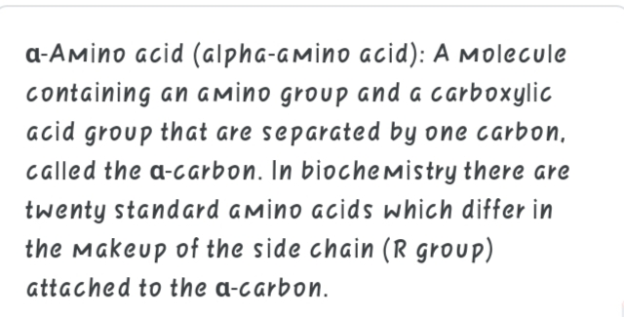
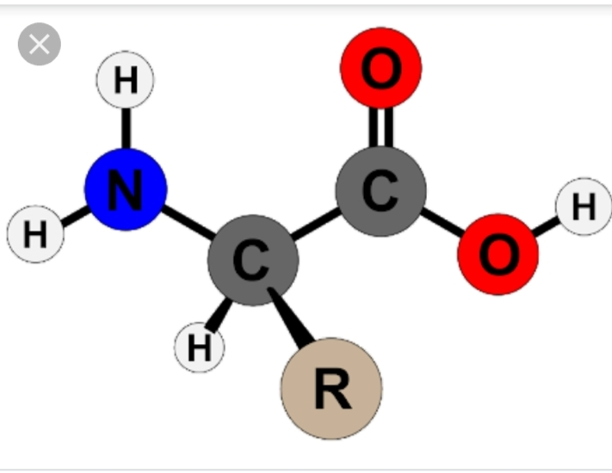
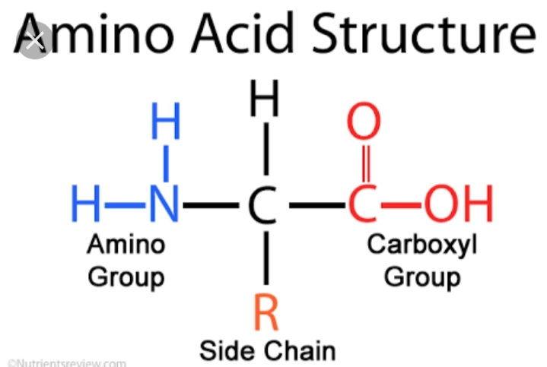

Slide 3
There are 22 standard amino acids , only 21 are found in eukaryotes.Out of 22 , 20amino acids directly encoded by the universal genetic code.
Each amino acid , except glycine shows :
CHIRALITY
ISOMERISM
OPTICAL ACTIVITY AND STEREOISOMERISM

Slide 4
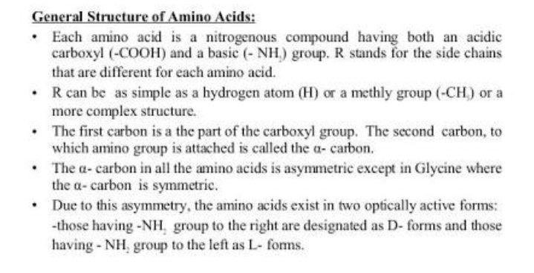
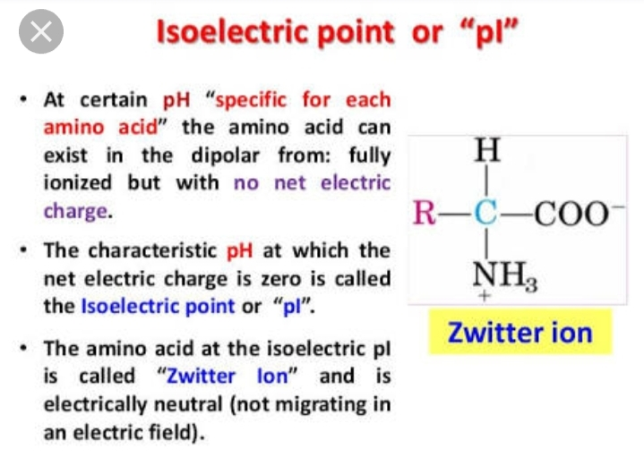

Slide 5
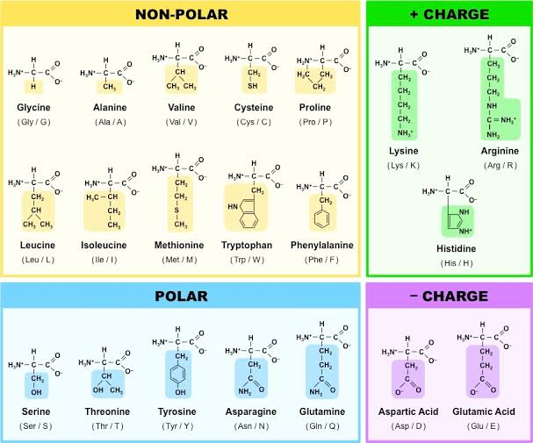

Slide 6
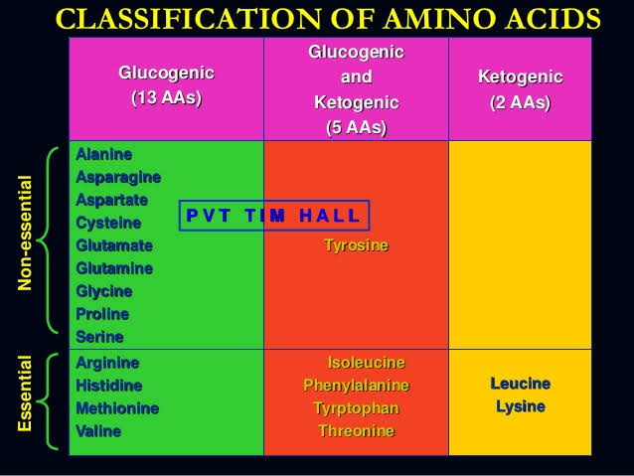
GLUCOGENIC AMINOACID :A glucogenic amino acid is an amino acid that are converted into glucose via gluconeogenesis.
KETOGENIC AMINO ACID : Aketogenic amino acid is an amino acid that can be degraded directly into acetyl – co-A , which is the precursor of ketone bodies.

Slide 7
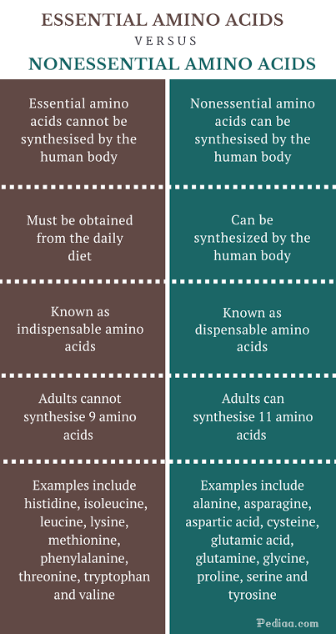

Slide 8
